Slide 1

Subnet Mask

Slide 2
Subnet Mask
We identify a computer or a device on a network by its IP address
IPv4 is a 32 bit numeric address
192 . 168 . 1 . 0
11000000.10101000.00000001.00000000
192 . 168 . 1 . 0
Octet
Notes:
IP address tells how to reach a computer
32 bits are divided into 4 octets
Computer sees IP address in binary
2**8 = 256
0 to 255

Slide 3
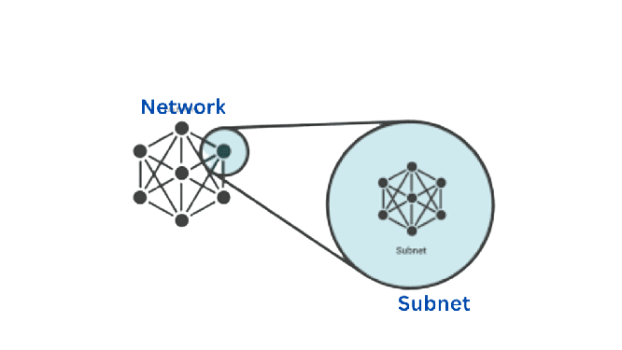
Subnet Mask
A subnetwork or subnet is a logical subdivision of an IP network.
IP addresses have a network and host part, so networks can be logically broken down into smaller networks, which is known as subnetting
Notes:
Logical break down of a network
Example: College has its own network which can be divided into subnets for each department
It helps to keep the department traffic separate

Slide 4

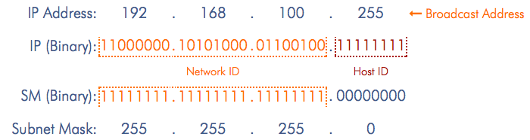
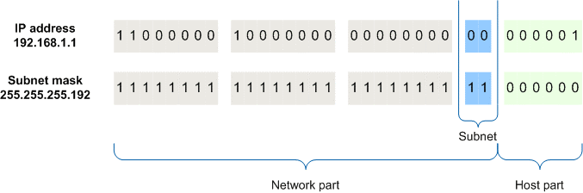
Subnet Mask
A subnet mask is a 32-bit number created by setting host bits to all 0s and setting network bits to all 1s
Notes:
Subnet mask helps identify the network and host part in an IP address

Slide 5
Subnet Mask
A subnet mask is a 32-bit number created by setting host bits to all 0s and setting network bits to all 1s

Slide 6
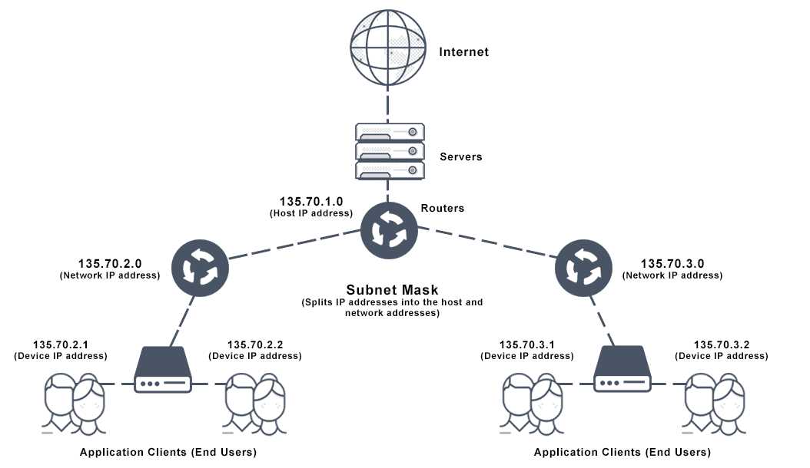

Slide 7
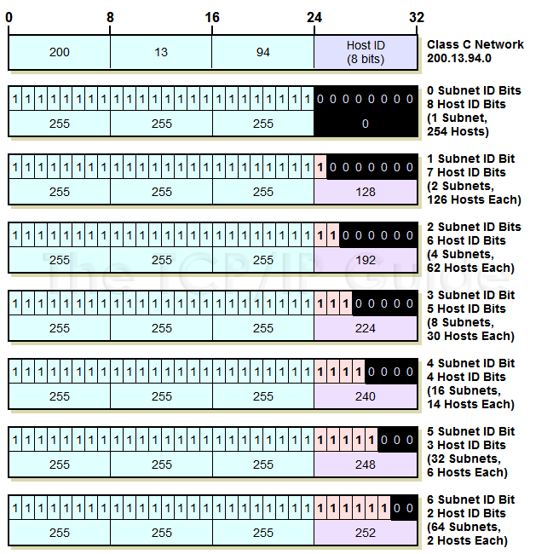

Slide 8
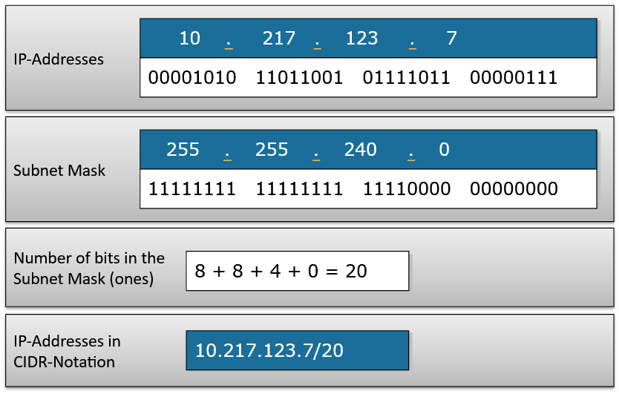
CIDR
Classless Inter-Domain Routing (slash notation)

Slide 9
CIDR
Classless Inter-Domain Routing (slash notation)
Thank
You

